Slide 1

Secure Chama: Digitizing Community Finance
A Full-Stack Solution for Trust and Transparency
Hello, and welcome. My name is Evans Mwaura Mburu, a final-year Computer Science student at Dedan Kimathi University of Technology. Today, I am presenting my capstone innovation titled 'Secure Chama.'
This project is born out of a specific need I observed in my community in Kiambu. It is a web-based platform designed to digitize informal investment groups, popularly known as 'Chamas.'
This project leverages my skills in Spring Boot and Angular to solve the age-old problem of financial mismanagement in community groups.

Slide 2
The Challenge: Informal & Insecure Financial Management
Let’s start with the problem. If you grew up in Kenya, you know that the 'Chama' is the backbone of our local economy. However, the management of these groups is stuck in the past, leading to significant challenges.
Manual Records
Lack of Transparency
Security Risks
Reliance on physical 'Black Books' leads to data loss. Everything is written in a physical exercise book—often kept by one person, the treasurer. If that book gets lost, or if coffee spills on it, years of financial history are destroyed.
Members cannot verify balances in real-time. A member contributes money every month but has no way of verifying the total unless they ask the treasurer. This creates an environment ripe for mistrust and potential disputes.
Physical cash handling and weak data storage. Relying on manual calculations leads to errors, and without digital backups, fraud is easy to hide. My goal was to stop this using technology.

Slide 3




The Innovation: Secure Chama - A Web-Based Platform
Enter Secure Chama. This is not just a website; it is a full management system designed to revolutionize how Chamas operate. It addresses the core issues of informal financial management head-on.
Digitization
Accessibility
Trust & Transparency
Automates record-keeping for contributions, loans, and fines. The system instantly updates records when a member pays and automatically calculates loan interest, eliminating human error and ensuring accuracy.
A responsive web app accessible via mobile devices. I used Angular to ensure the frontend adjusts perfectly to any screen, whether a laptop in Nairobi or a smartphone in a rural village in Ruiru.
Real-time visibility of funds for all members. Any member can log in at any time to see the group's total funds, outstanding loans, and full transaction history. Transparency is no longer a request; it is a built-in feature.

Slide 4
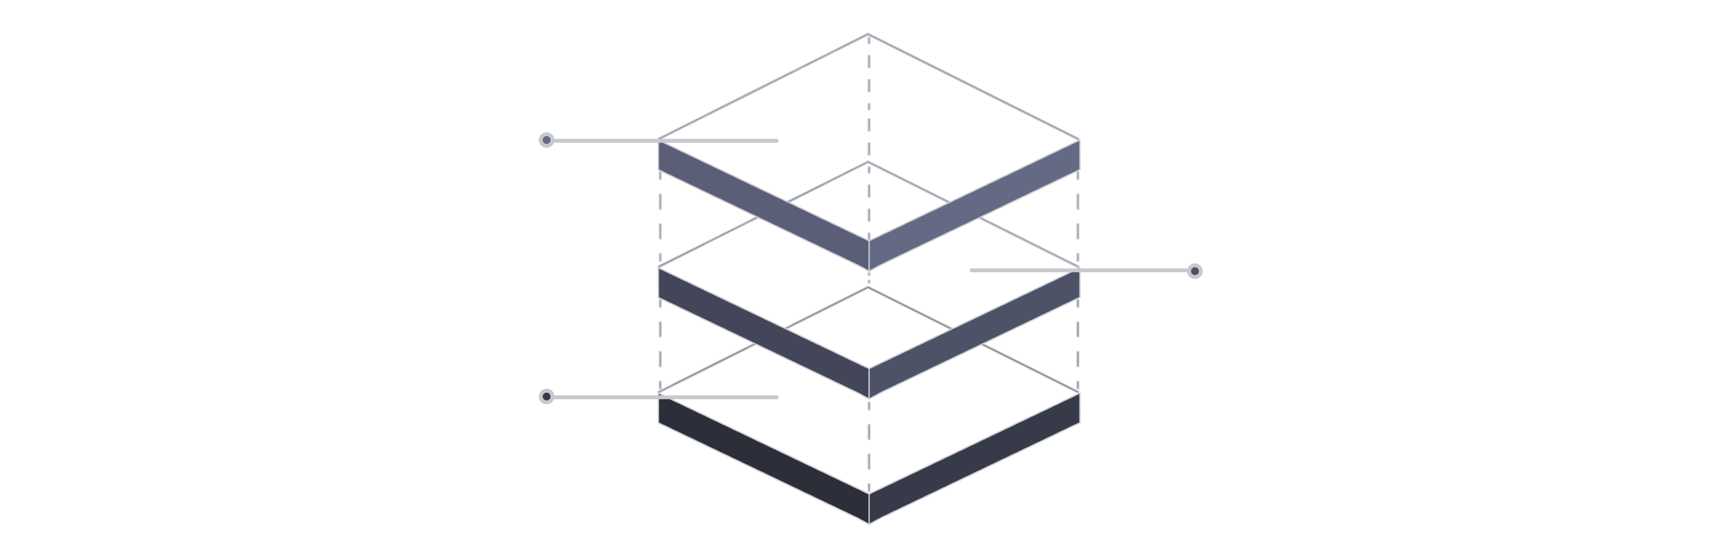
Technical Architecture: Under the Hood
As a Computer Science student, selecting the right tech stack was critical for building a robust and scalable solution. Secure Chama's architecture is designed for performance, security, and maintainability.
Database
MySQL for durable relational storage
Backend
Spring Boot REST API and business logic
Frontend
Angular SPA for user interactions
Frontend: Angular (TypeScript)
Backend: Spring Boot (Java)
Database: MySQL
Chosen for its Single Page Application (SPA) architecture, providing a fast and native-like user experience. TypeScript helps catch errors during development, ensuring a more stable and reliable application.
Utilized as the industry standard for enterprise-level applications. Spring Boot handles the heavy lifting, including complex business logic, session management, and processing all API requests securely and efficiently.
Selected for relational data storage. Financial data, with its inherent relationships (users to loans, loans to repayment schedules), benefits greatly from a relational database to ensure data integrity and consistency.

Slide 5


Ensuring Security & Integrity: The Core of Secure Chama
This project is titled 'Secure Chama' for a reason. Security was my top priority, implementing robust measures to protect sensitive financial data and prevent fraud.
Authentication: JWT
Data Encryption: Bcrypt
Implemented JSON Web Tokens (JWT) for stateless, secure login. Upon successful login, the server issues a secure token, which is then required for every subsequent request, ensuring that only authorized users can access sensitive financial data.
Passwords are protected using Bcrypt hashing. This means that even if the database were compromised, user passwords would remain unreadable, stored only as scrambled, irreversible hashes.
Audit Trails: Immutable Logs
In a financial system, data integrity is paramount. My system maintains immutable logs of every transaction. Any movement of money creates a digital footprint that cannot be erased, serving as the ultimate deterrent against fraud and ensuring accountability.

Slide 6

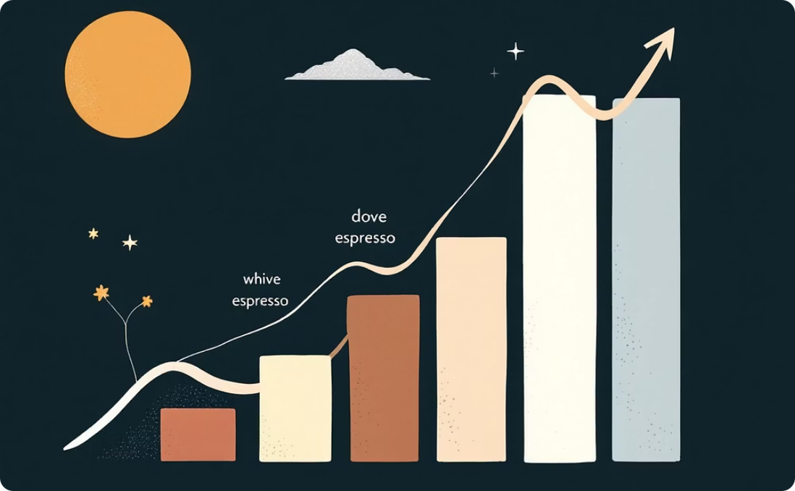

Impact on the Community: Empowerment and Growth
Secure Chama is more than just code; it is a powerful tool for economic empowerment, designed to foster trust, encourage savings, and drive investment within communities.
Empowerment
Scalability
Future Integration
By giving members direct control and real-time access to their financial data, Secure Chama empowers them to make informed decisions, fostering greater financial literacy and participation.
While built with my local community in Kiambu in mind, the system is designed for broad deployment. It is ready to serve thousands of Chamas across Kenya, adapting to various group sizes and needs.
The next phase involves integrating with Safaricom's M-Pesa Daraja API. This will enable automatic detection of payments to the group's Paybill number, updating records without manual intervention and streamlining operations.

Slide 7

The Journey: Solving Real Problems with Technology
This innovation represents my journey as a developer—a commitment to solving real-world problems with secure, modern technology. It's about translating academic knowledge into practical solutions that benefit society.
My experience at Dedan Kimathi University of Technology has equipped me with the skills to identify critical needs within my community and develop robust solutions. Secure Chama is a testament to the power of computer science in addressing everyday challenges.
The process involved extensive research, meticulous planning, and iterative development, ensuring that the platform is not only functional but also user-friendly and highly secure. Every line of code was written with the end-user in mind, aiming to simplify complex financial processes.
This project has deepened my understanding of full-stack development, from designing intuitive user interfaces with Angular to building resilient backend services with Spring Boot, and ensuring data integrity with MySQL.

Slide 8
Abstract: Secure Chama in English
Secure Chama is a web-based platform designed to digitize and enhance the management of informal investment groups (Chamas) in Kenya. Addressing prevalent issues such as manual record-keeping, lack of transparency, and security vulnerabilities, the system provides automated record-keeping for contributions, loans, and fines. It offers real-time financial visibility to all members through a responsive Angular frontend, a robust Spring Boot backend, and a MySQL database. Key security features include JWT authentication, Bcrypt password hashing, and immutable audit trails, ensuring data integrity and fraud prevention. This innovation aims to empower communities by fostering trust, promoting financial accountability, and providing a scalable solution for modernizing traditional Chama operations, with future integration planned for Safaricom's M-Pesa Daraja API.

Slide 9
Abstract: Secure Chama in Kiswahili and Kikuyu
Kiswahili Abstract
Kikuyu Abstract
Secure Chama ni mfumo wa wavuti ulioundwa kuboresha na kuweka kidijitali usimamizi wa vikundi vya uwekezaji visivyo rasmi (Chamas) nchini Kenya. Ukishughulikia masuala kama vile uhifadhi wa kumbukumbu kwa mikono, ukosefu wa uwazi, na udhaifu wa kiusalama, mfumo huu unatoa uhifadhi wa kumbukumbu otomatiki kwa michango, mikopo, na faini. Unatoa uwazi wa kifedha wa wakati halisi kwa wanachama wote kupitia mfumo wa mbele wa Angular unaojibu, mfumo imara wa nyuma wa Spring Boot, na hifadhidata ya MySQL. Vipengele muhimu vya usalama ni pamoja na uthibitishaji wa JWT, usimbaji fiche wa nenosiri wa Bcrypt, na njia za ukaguzi zisizobadilika, kuhakikisha uadilifu wa data na kuzuia udanganyifu. Ubunifu huu unalenga kuwezesha jamii kwa kukuza uaminifu, kuendeleza uwajibikaji wa kifedha, na kutoa suluhisho linaloweza kupanuka kwa ajili ya kurekebisha shughuli za Chama za kitamaduni, na ushirikiano wa baadaye umepangwa kwa API ya M-Pesa Daraja ya Safaricom.
Secure Chama nĩ mũtaratara wa web ũrĩa wathondekwo nĩguo ũtũmĩre tekinorojĩ ya kĩdigitari na ũkĩrie ũtongoria wa mĩthithũ ya mĩgũnda (Chamas) bũrũri-inĩ wa Kenya. Ũkĩrũgamĩrĩria mathĩna ta kũandĩka maũndũ na moko, kũaga kwa ũthirũkĩri, na mathĩna ma ũgitĩri, mũtaratara ũyũ ũheaga kũandĩka maũndũ kĩdigitari ma mĩhothi, mĩkopo, na ciĩko. Ũheaga ũthirũkĩri wa mbeca wa ihinda rĩa rĩu kũrĩ arĩa othe marĩ thĩinĩ wa Chama kũgerera gĩcunjĩ kĩa mbere kĩa Angular kĩrĩa kĩrĩ responsive, gĩcunjĩ kĩa thutha kĩa Spring Boot kĩrĩa kĩrĩ kĩnene, na database ya MySQL. Maũndũ ma bata ma ũgitĩri nĩ hamwe na JWT authentication, Bcrypt password hashing, na immutable audit trails, kũrĩa kũgitĩraga data na kũgirĩrĩria ũkoroku. Ũthondeki ũyũ ũrĩ na muoroto wa kũhe hinya mĩtũũrĩre kũgerera kũgĩa na wĩhokano, kũgĩa na ũtongoria wa mbeca, na kũhe mũtaratara ũrĩa ũrĩ scalable wa kũthondeka maũndũ ma Chama ma tene, na kũgĩa na ũrũmĩrĩri wa Safaricom M-Pesa Daraja API hĩndĩ ya kĩama.

Slide 10



Thank You: Future of Secure Chama
Thank you for listening. This innovation represents my journey as a developer—solving real problems with secure, modern technology. I am excited about the future potential of Secure Chama and its ability to transform community finance.
I envision Secure Chama becoming a cornerstone for financial stability and growth in informal investment groups across Kenya, continuously evolving to meet the dynamic needs of its users.
Your feedback and insights are invaluable as I continue to refine and expand this platform. Together, we can build a more transparent and secure financial future for our communities.

